Slide 1
Market, Industry, and Investment Challenges in a Low Commodity Price Environment PJM Roundtable
Power, Fuel, & Commodity Market Overview
Andrew Waranch
Wednesday June 29th, 2016

Slide 2
Boom Bust Cycle of Commodities
1990 to 1998 | total growth of | 5.55%
1998 to 2003 | total growth of | 24.83%
1990 to 2003 | total growth of | 31.76%
for a compound annual rate of 5.25%

Slide 3
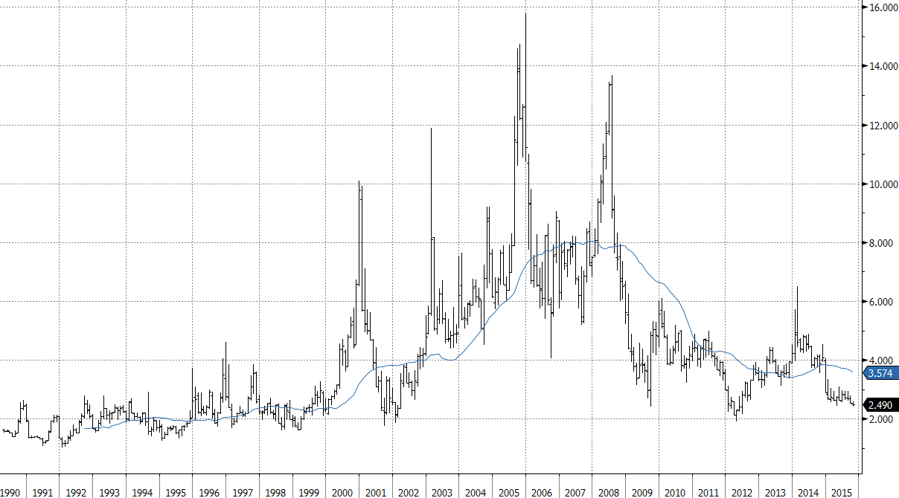
Monthly Prompt Henry Hub Natural Gas | 1990 to Date
1998 to 2008
Generation Growth
2012 and Beyond
Demand Investment
2008 to 2012
Shale Boom
1990 to 1997
No New Generation

Slide 8
10.9 Spark On-Peak Whub RT vs Eastern Blend

Slide 9
HR On-Peak Whub RT vs Eastern Blend

Slide 10
7.5 Spark Off-Peak Whub RT vs Eastern Blend

Slide 11
HR Off-Peak Whub RT vs Eastern Blend

Slide 13
National Generation - Total MWH

Slide 16
Over production from new mines, new gas, global recession

Slide 24
Non Commodity Changes
Carbon - The Great Unknown
PJM – Transmission upgrades to alleviate congestion, AND changes to long term reservations
MISO – More plants exiting?, more wind, more retirements, more gas backing up from the East
NYISO - Nukes Closing, New Canadian import lines, New Gas Pipelines, Upgraded NYISO Zone A imports
Southeast – more gas pipeline with delays, more LNG exports, new nukes

